Slide 1
Estimation of Body Fat Percentage
Group2
David Gao
Shuwei Liu
Marwan Lloyd

Slide 2
Contents
Data Cleaning
Model Selection
Final Model and Description
Model Diagnostics
Strengths and Weaknesses

Slide 3
Data Cleaning
We standardized units to metric:
Measure | Prev | New
Height | In. | Cm.
Weight | Lbs. | Kgs.
We imputed individual 42’s height from his adiposity due to his originally recorded height being <100 cm
ID | Height (cm) | Corrected Height (cm)
42 | 74.93 | 176.53
We removed records for individuals 172 & 182 due to their body fat not recorrecting via density
ID | BodyFat | Density
182 | 0 | 1.10
172 | 1.9 | 1.09
Final cleaned data: n=250 (from n=252) with p=14 predictors (density was removed)

Slide 4
Model Selection
Accuracy: Adjusted R-squared
Interpretability
Simplicity
Method | Model | Adjusted R-squared
PCA+Stepwise | BODYFAT~ PC1 + PC2 + PC3 + PC5 + PC6 + PC8 | 0.7190
Stepwise | BODYFAT ~ AGE + WEIGHT + NECK + ABDOMEN + THIGH + FOREARM + WRIST | 0.7312
MLR | BODYFAT ~ AGE + WEIGHT | 0.4434
MLR | BODYFAT ~ FOREARM + WRIST + ABDOMEN | 0.6926
MLR | BODYFAT ~ AGE + WEIGHT + ABDOMEN | 0.7102
MLR | BODYFAT ~ WEIGHT + ABDOMEN | 0.7111

Slide 5
Final Model
Body Fat% = -40.47 - 0.31 * Weight (kg) + 0.91 * Abdomen (cm)
 | Intercept | Weight | Abdomen
Estimation | -40.47 | -0.31 | 0.91
Standard Error | 2.42 | 0.09 | 0.05
P-value | < 2e-16*** | 4.84e-12*** | < 2e-16***
If a man’s abdomen circumference increases by one cm but his weight does not change, he is expected to gain 0.91% in body fat.
If a man gains a kg without an increase in abdomen circumference, he is expected to lose 0.67% in body fat.
Negative factor with weight: if people are gaining more weight without abdomen growth, they are probably gaining lean body tissue in other parts of their body (e.g. muscle mass) & thus their overall body fat % decreases.

Slide 6
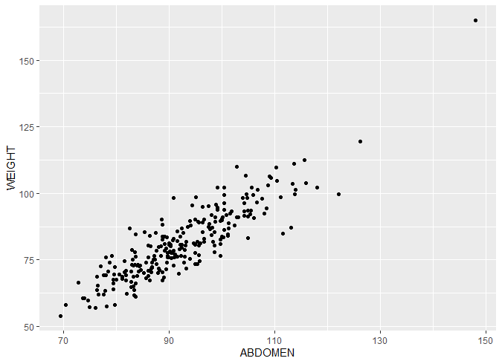
Collinearity Check
Check | Weight | Abomen
VIF | 4.73 | 4.73
1<VIF<5, which suggests that there is a moderate correlation, but it is not severe enough to warrant corrective measures

Slide 7
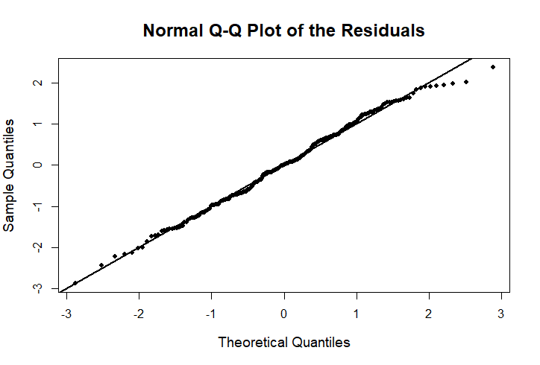
Model Diagnostics
Normality:
Reasonable: Hug the 45 degree line very closely
Slightly left skewed（2 to 3)
Slight skinny tail

Slide 8
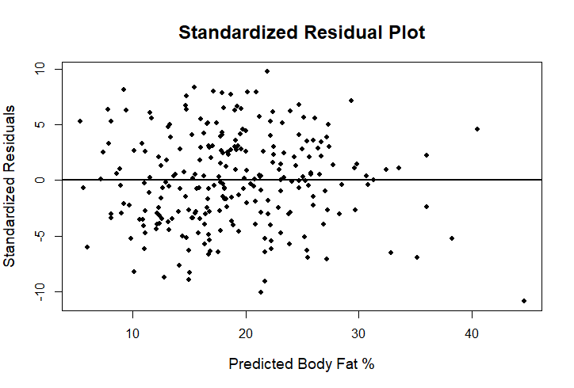
Model Diagnostics
Linearity:
Reasonable: No obvious non-linear trends
Homoskedasticity:
Plausible
Slight pattern for BodyFat%>30%

Slide 9
Strengths and Weaknesses
Body Fat% = -40.47 - 0.31 * Weight (kg) + 0.91 * Abdomen (cm)
Strengths:
Simple enough for users without heavy loss of accuracy
Explains weight and abdomen circumference of variation in body fat
Provides explanation for differing body types via inclusion of Abdomen
Weaknesses:
Requires units
Trained on data that does not contain many extreme weights or abdomen sizes (on either end) and so extrapolation issues may arise for edge case individuals

Slide 10
Thank you
Group2
David Gao
Marwan Lloyd
Shuwei Liu

